Slide 1


Subscribers
Analysis
Presented by Surya Teja

Slide 2

Project Recap
Problem Analysis
Agenda
Process
Our Key Discussion Points
Data Visualization
Summary and Analysis
Thank You Page

Slide 3


Introduction of Project
Who is our Target Audience?
The analysis focuses on subscription trends, customer demographics, and engagement patterns using data on subscription plans, payment methods, and regional preferences collected over 2 years.

Slide 4
Process
Data Collecting
Data Understanding
Data Cleaning
Data Modeling
Data Visualization

Slide 5
Insights
$5.264 B
Total Revenue
4.0
Average Rating
December
is Highest Sales
Total revenue is based on 2003 data, and these values may not reflect real-time performance.

Slide 6
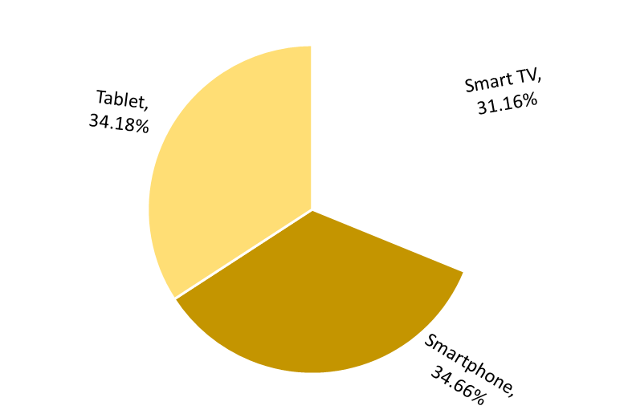
Device Users
Description:
Amazon users are predominantly smartphone users, with 34.66% of customers accessing the platform through their mobile devices. Tablets and smart TVs follow with similar usage percentages, highlighting the importance of optimizing the Amazon experience across these devices.

Slide 7
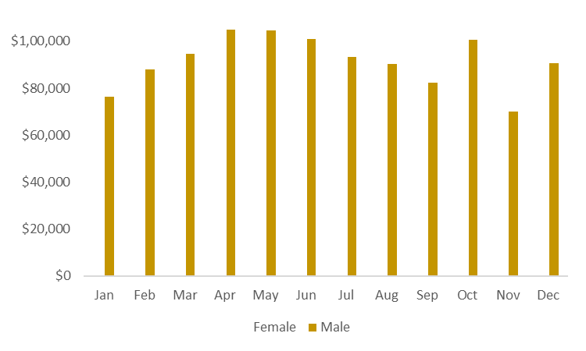
Sales Revenue Trends by Gender
Description:
This bar chart compares monthly Amazon user activity by gender, highlighting spending trends across the year. Male users generally spent more than female users, with the highest activity observed in May and December, exceeding $1,00,000. Female users maintained steady spending with noticeable peaks in December.

Slide 8
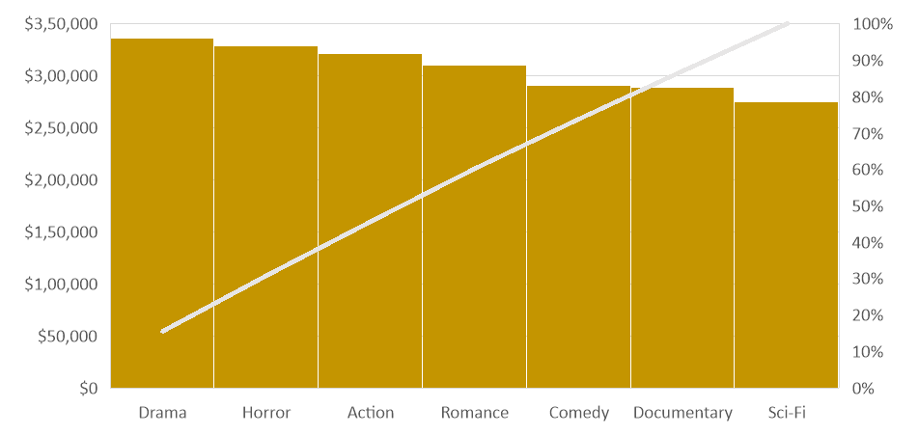
Top-Grossing Movie Genres
Description:
The Drama genre attracts the highest number of users, suggesting that adding more titles in this category could further boost viewer engagement. Other genres like Horror, Action, and Romance also contribute significantly to the overall revenue.

Slide 9
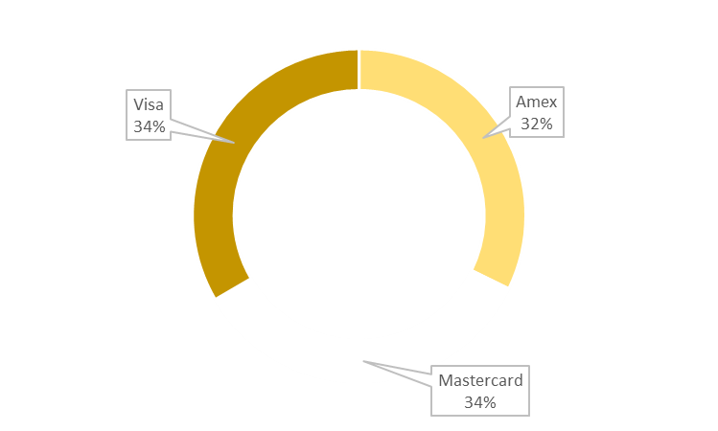
Payment Methods
Description:
Users mostly pay with credit cards, like Mastercard, Visa, and American Express. Giving offers on these cards can attract more people to use the service.

Slide 10

Device Usage: Most people use smartphones (34.66%) to access Amazon. Improving the app for mobile users and adding features for tablets and smart TVs can help attract more customers.
Summary and Analysis
Gender Spending Trends: Male users spend more, especially in May and December. Female users also spend more in December. Special offers during these months can boost sales.
Popular Movie Genres: Drama movies are the most liked by users, followed by Horror, Action, and Romance. Adding more Drama movies can attract viewers and increase sales.
Payment Methods: Credit cards like Mastercard, Visa, and American Express are the most used. Giving discounts or cashback on these cards can bring in more buyers.

Slide 11

Action Items
To be start next step:
More market research
Assign attractive genre
Understand the main audience better
Plan campaigns for May and December

Slide 12

Thank you!
Surya Teja Mukka

